Slide 1
From Forge to Function: AI-Powered Strategies that Transform Teacher Preparation
OCTEO Conference – Dublin, Ohio | 2025
Thomas Betsa, PhD, Walsh University

Slide 2


Conference Theme: Forging Ahead
Innovations in Teaching & Research

Slide 3
Session Roadmap
01
02
Why
Forging the Tools
03
04
Methodology
Analysis
Context & Why AI Matters
Practical Applications in Teacher Preparation
You can describe the topic of the section here
You can describe the topic of the section here

Slide 4
Why We’re Here
01
Context & Why AI Matters to Teacher Prep

Slide 5
The Current Landscape
Must Adapt to Evolving AI
Transforming Education Worlwide
75% of Educators report AI Use
Our goal: To prepare future educators who can
harness this technology effectively and ethically.

Slide 6
—David Brook, NYT
“A.I. will force us humans to double down on those talents and skills that only humans possess. The most important thing about A.I. may be that it shows us what it can’t do, and so reveals who we are and what we have to offer.”

Slide 7
AI in Teacher Preparation
1
2
3
AI Support!
Equips Candidates
Boosts Efficiency
Fosters Innovation
Problems

Slide 8
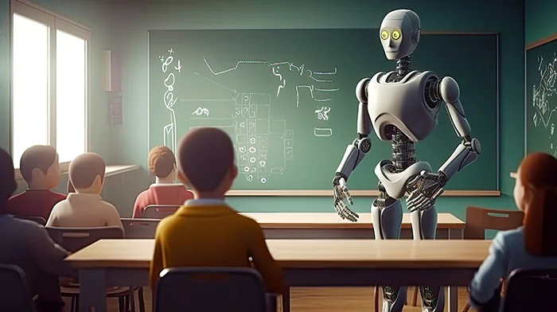
Common Misconception
AI is a replacement for teachers?

Slide 9
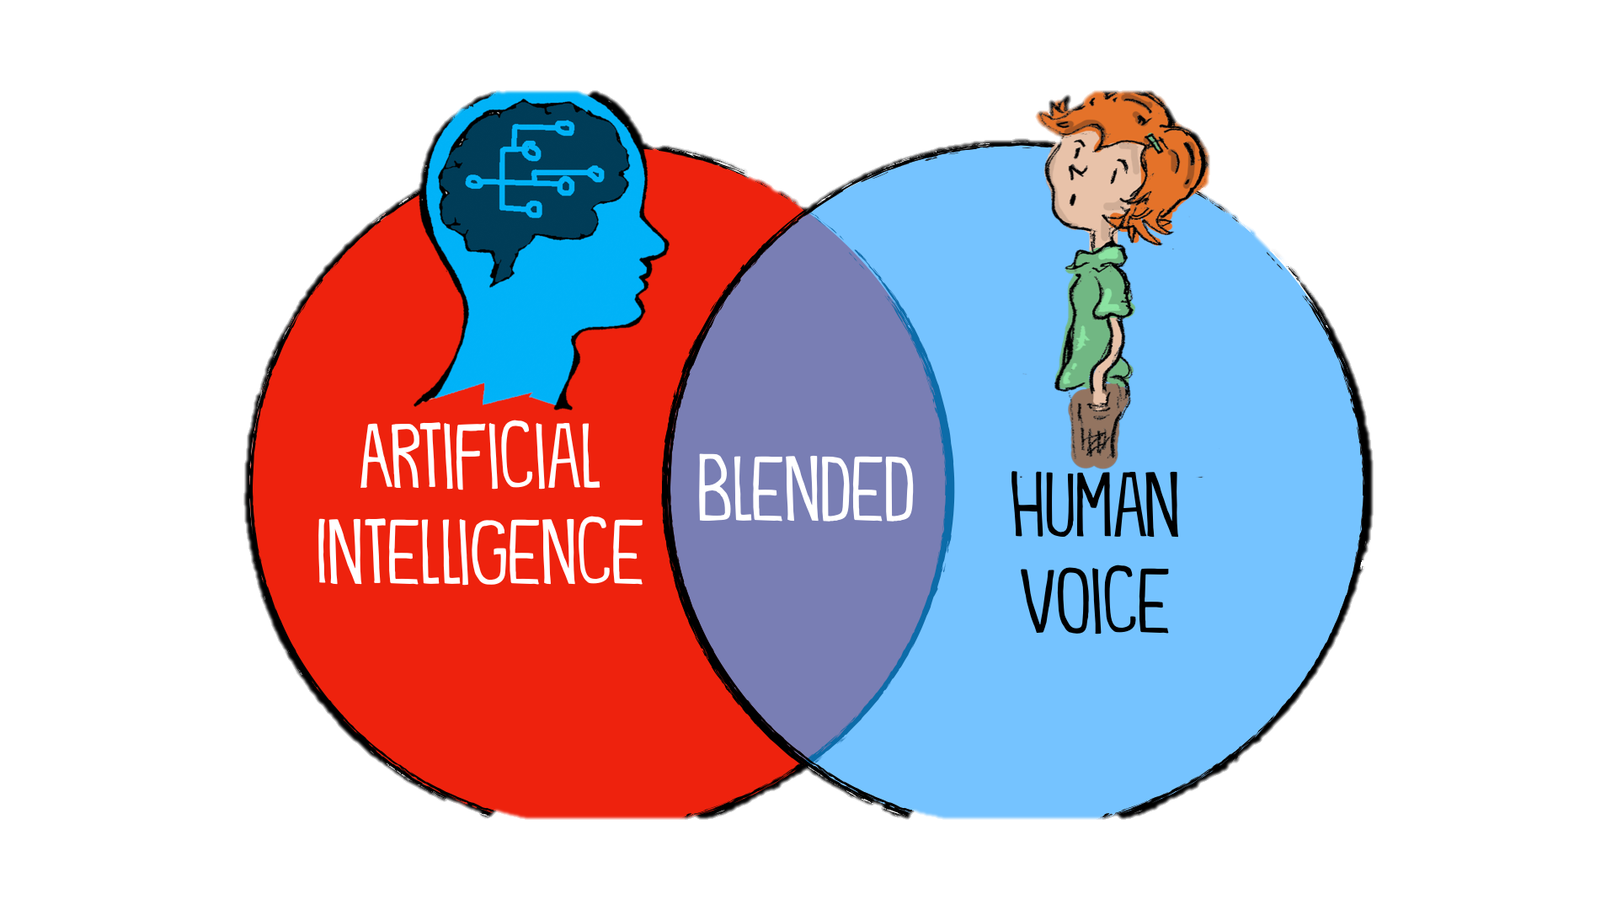
Common Misconception – Fixed!
AI is a scaffold that supports creativity & efficiency
Our focus today: Enhancing, not replacing, the educator's role.

Slide 10

Research Base
Holmes et al. (2023):
  AI supports instructional design
Luckin (2021)
  AI as scaffolding for teacher thinking
Trust & Whalen (2023)
  Emerging practices in teacher prep
Southworth & Watson (2024)
  AI in candidate reflection

Slide 11
Forging the Tools
02
Practical Applications & Demos

Slide 12


Lesson Planning with AI
🔧 Tool: ChatGPT or Gemini
💡 Sample Prompt:
Create a 5E lesson on ecosystems for 7th grade, aligned to NGSS, including vocabulary scaffolds for English learners.
• Generate lesson outlines aligned to standards
• Create scaffolding supports for diverse learners
• Save time on routine instructional tasks

Slide 13

Differentiation Strategies
🔧 Tool: Diffit.me
💡 Sample Prompt:
Adapt this passage for grades 3, 6, and 9, with simplified language and comprehension questions.
• Multiple versions of the same task
• Reading passages at varied levels
• Scaffolding prompts for diverse needs

Slide 14

Assessment & Feedback
🔧 Tool: MagicSchool.Ai
💡 Sample Prompt:
Generate a rubric for a persuasive essay, aligned with Ohio ELA standards.
• AI-generated rubrics and formative assessments
• Support for timely, actionable feedback
• Candidate practice in reviewing/adjusting AI outputs

Slide 15

Reflection & Growth
🔧 Tool: Educaide.Ai
💡 Sample Prompt:
Generate three reflective journal prompts for a student teacher completing their
first classroom management experience.
The "Reflective Journaling" tool generates prompts
that help students engage in metacognitive
development and connect learning to new contexts

Slide 16

Faculty Productivity Tools
🔧 Tool: Perplexity.ai or Microsoft Copilot
💡 Sample Prompt:
Draft a professional but encouraging email to a student who missed class due to illness.
• Drafting syllabi or assignment descriptions
• Summarizing data for accreditation reports
• Automating repetitive communication tasks

Slide 17

Interactive Demo
🔧 Tool: You Choose!
💡 Sample Prompt:
Create a quick lesson outline on [topic from audience].
Live Example: Generating a lesson plan with AI
Step 1: Input prompt aligned to standards
Step 2: Review output for rigor & inclusivity
Step 3: Adapt for classroom use

Slide 18

Critical Review Exercise
Discussion Questions:
– Is it culturally responsive?
– Does it align with standards?
– What needs revision?

Slide 19



Transfer to PK-12
Mentor & Candidate Co-planning
AI Tools in Student Teaching
Collaboration & Reflection

Slide 20


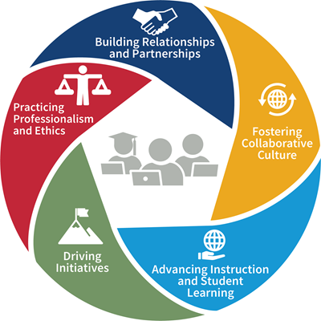

Connection to Standards

Slide 21

Ethics in AI
Plagiarism?
Responsible Use
Model discernment
Honesty
Discernment
Data biases?
Risk exclusion, blind spots
Critical evaluation!!
Bias & Equity

Slide 22

Scenarios for Discussion

Slide 23
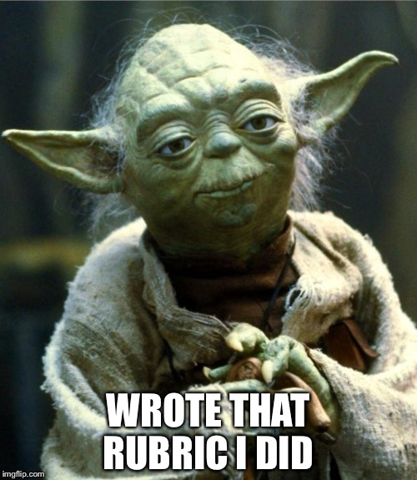

Slide 24
Actionable Insights
AI is a scaffold
Practical Applications
Ethics & Equity
Model!!

Slide 25
Resources
Holmes et al. (2023), Luckin (2021)
Trust & Whalen (2023), Southworth & Watson (2024)

Slide 26


Thanks!
Do you have any questions?
tbetsa@walsh.edu
330.490.7603

